Slide 1


Oracle database
Lecture 15

Slide 2

Today’s Agenda
Introduction To GROUP Functions
Types Of GROUP Functions
Introduction To MISCELLANEOUS Functions
Types Of MISCELLANEOUS Functions

Slide 3
Group Functions
Group functions are built-in Oracle functions that operate on groups of rows and return one value for the entire group.
So instead of operating on one row at a time and returning the result , they operate on a set of rows and return one result for the entire set.
Due to this behaviour they are also called aggregate functions

Slide 4
Group Functions
These functions are:
SUM
MAX
MIN
AVG
COUNT

Slide 5
The Function SUM ()
This function returns the sum of the values of a numeric column without considering NULL values
Syntax
SUM(col_name or expr)
Arguments:
Col_name or expr : This is the column name on which the function will be applied. We also can pass the an expression which results into a numeric value

Slide 6
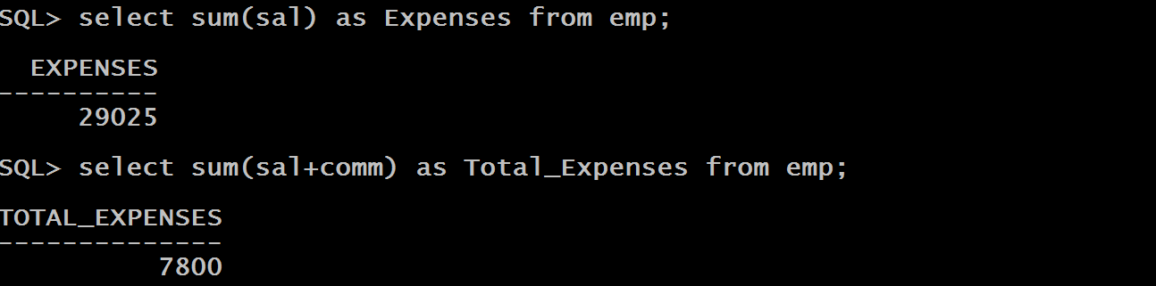
Examples

Slide 7
The Function AVG ()
This function returns the average of the values of a numeric column without considering NULL values
Syntax
avg(col_name or expr)
Arguments:
Col_name or expr : This is the column name on which the function will be applied. We also can pass the an expression which results into a numeric value

Slide 8
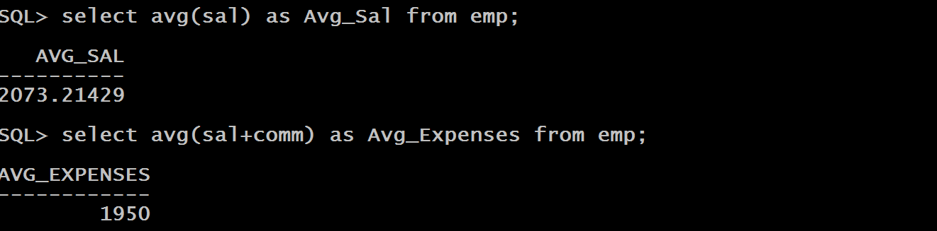
Examples

Slide 9
The Function MAX () And MIN()
These functions return the max and min of the values of a column without considering NULL values
Syntax
max(col_name or expr)
min(col_name or expr)
Arguments:
Col_name or expr : This is the column name on which the function will be applied. We also can pass the an expression which results into a numeric value

Slide 10
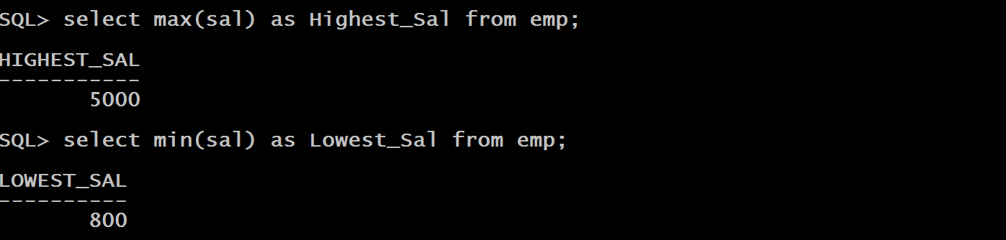
Examples

Slide 11
The Function COUNT()
This function returns the number of values present in a column without considering NULL values
Syntax
COUNT(Col_name or expr or *)
Arguments:
Col_name or expr or value: This is the column name on which the function will be applied. We also can pass the an expression which results into a numeric value.
Count() also allows us to pass * , and in that case it counts all the rows irrespective of whether there is a null in it or not.

Slide 12
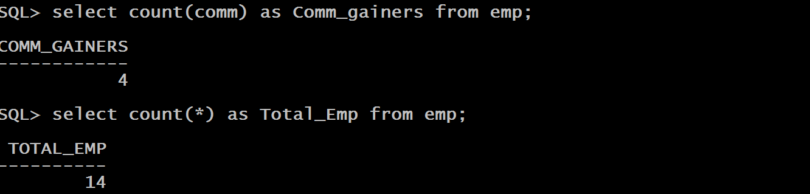
Examples

Slide 13

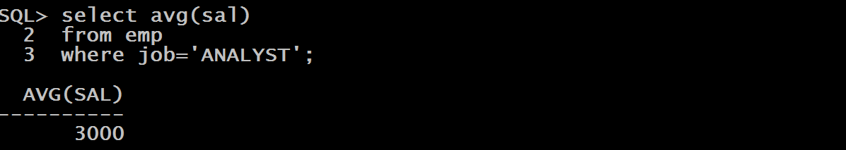
Queries
WAQ to display the date of last recruitment
WAQ to display average salary of ANALYST

Slide 14
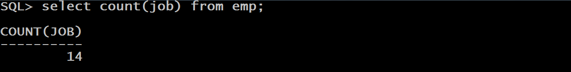
Queries
How many kinds of jobs are there in the company ?
If we closely observe the above query we will find out that it is not reporting kinds of jobs , rather it is reporting total number of posts in the company.
This is because the function COUNT() counts every row in the JOB column irrespective of values being repeated

Slide 15
Queries
To solve this issue , we must use the clause DISTINCT or UNIQUE
These clauses accept a column name and return only UNIQUE values of that column.

Slide 16


Queries

Slide 17
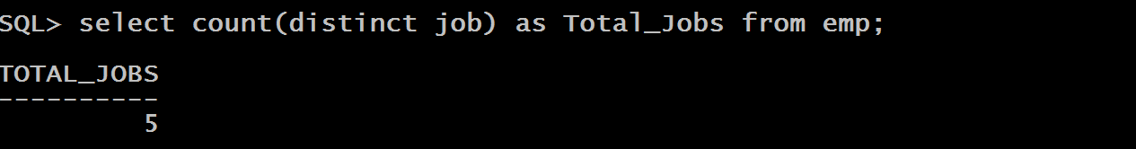
Queries
So the solution to our query will be

Slide 18
Miscellaneous Functions
Miscellaneous functions are those functions which do not belong to any particular category but can be used for many useful purposes.
These functions are:
NVL
NVL2
COALESCE
DECODE
USER

Slide 19
The Function NVL ()
This function converts a null value to an actual value.
Syntax
NVL(expression1,expression2)
Arguments:
Expression1 : This is the column name or expression which has to be checked for NULL.
Expression2 : This is the column name or expression which has to be returned if EXPRESSION1 is NULL.

Slide 20
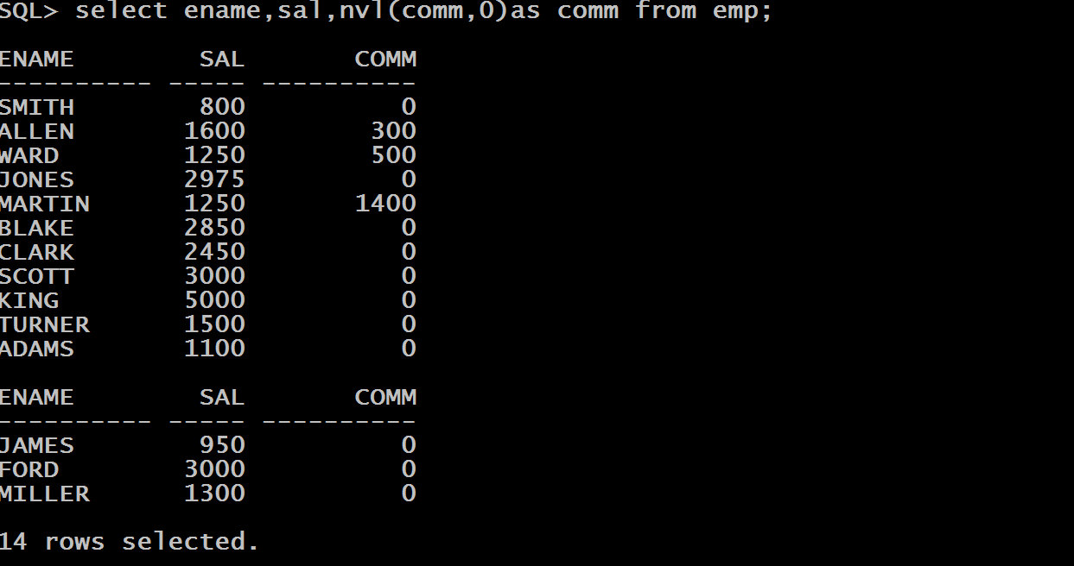
Examples

Slide 21
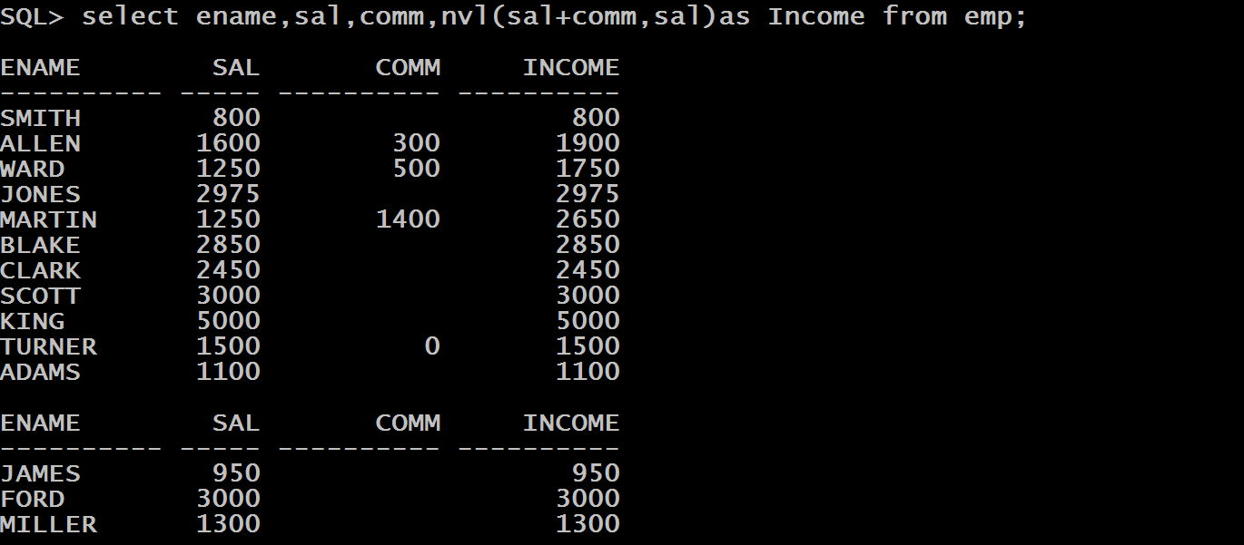
Queries
WAQ to display Ename,Sal,Comm and Total Income of all employees. Make sure to display salary if comm is null

Slide 22
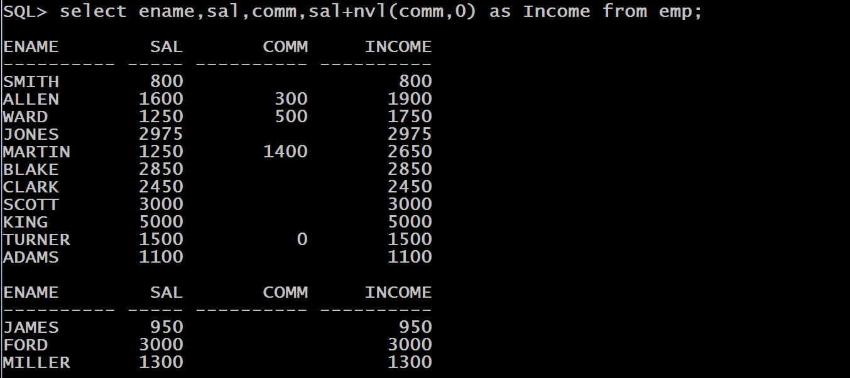
Queries
ALTERNATE SOLUTION:

Slide 23
The Function NVL2 ()
The NVL2() function examines the first expression. If the first expression is not NULL, then it returns the second expression. If the first expression is NULL, then the third expression is returned
Syntax
NVL2(expression1,expression2,expression3)

Slide 24
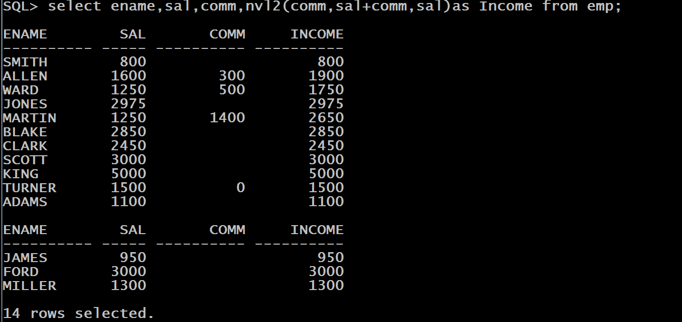
Queries
WAQ to display Ename,Sal,Comm and Total Income of all employees. Make sure to display salary if comm is null

Slide 25
The Function COALESCE ()
The COALESCE() function examines the first expression, if the first expression is not NULL, it returns that expression; Otherwise, it does a COALESCE of the remaining expressions. The advantage of the COALESCE() function over the NVL() function is that it can take multiple alternate values.
Syntax
COALESCE(expression1,expression2,expression3,……expression n)

Slide 26
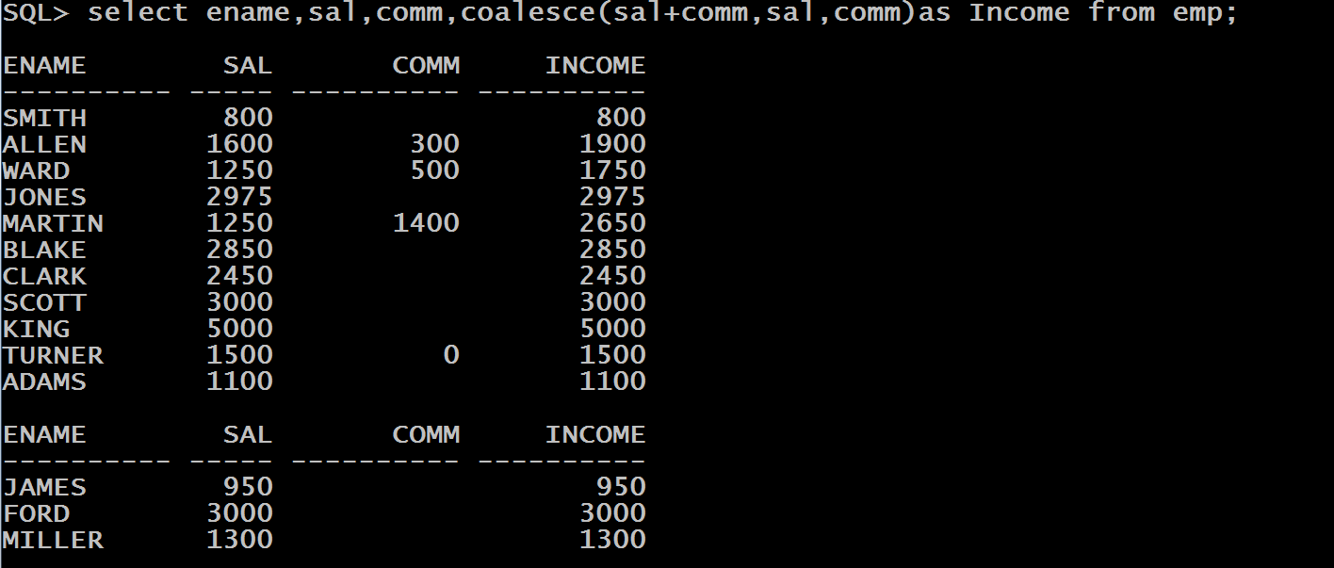
Queries
WAQ to display Ename,Sal,Comm and Total Income of all employees. Make sure to display salary if comm is null

Slide 27
The Function DECODE ()
This function facilitates conditional inquiries by doing the work of a CASE or IF-THEN-ELSE statement.
It decodes an expression in a way similar to the IF-THEN-ELSE logic used in various languages.

Slide 28
The Function DECODE ()
The DECODE() function decodes expression after comparing it to each search value.
If the expression is the same as search, then result is returned.
If the default value is omitted, a NULL value is returned where a col value does not match any of the search values.
Syntax
DECODE(col|expression, search1, result1 [, search2, result2,...,][, default])

Slide 29
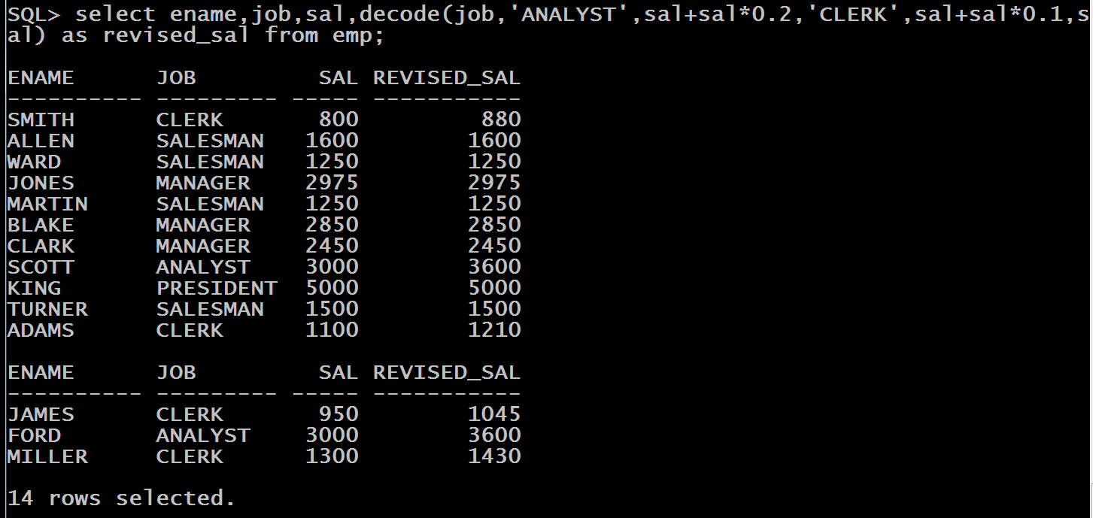
Queries
WAQ to display Ename ,Sal and Revised Sal of Employees. The condition is that for ANALYST , the increment is 20%, for CLERK the increment is 10% and no increment for others

Slide 30
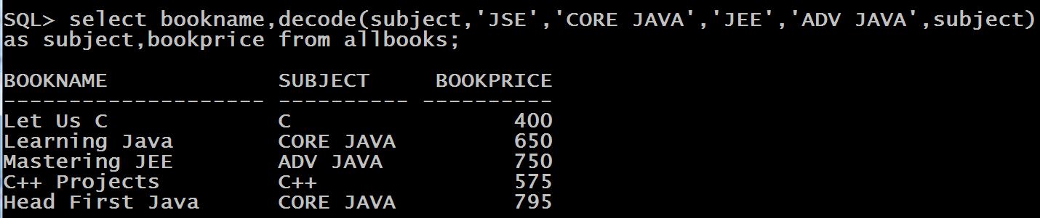
Queries
WAQ to display bookname ,subject and bookprice of all the boos from ALLBOOKS table. The condition is that for the subject JSE , display CORE JAVA and for JEE display ADV JAVA , while for others display actual subject name

Slide 31
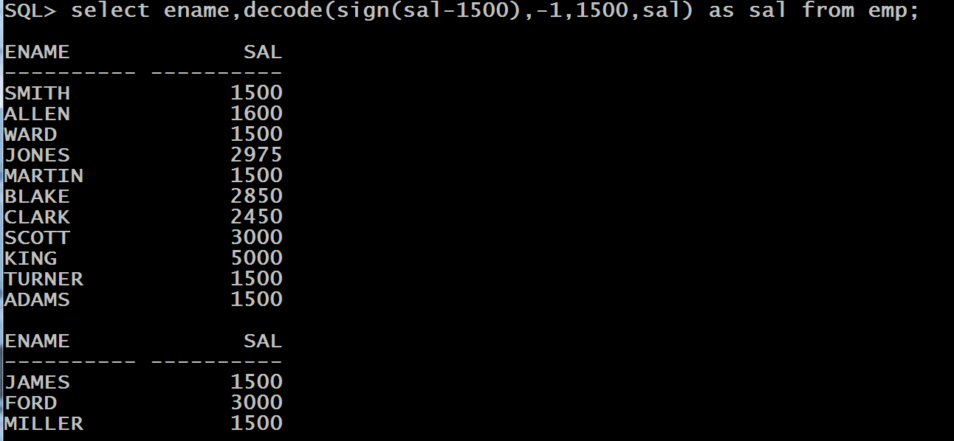
Queries
WAQ to display Ename and Sal of Employees. But the condition is that if SAL is less than or equal to 1500 , then display 1500 as salary and if it is more than 1500 then display the actual salary.

Slide 32

The Function USER()
This function returns the name of the CURRENT USER
Syntax
USER
Example

